Slide 1


PRUDENT GLOBALTECH SOLUTIONS
HOTELREVIEW
SENTIMENT ANALYSIS
By Team Member Chushritha Bandaru

Slide 2
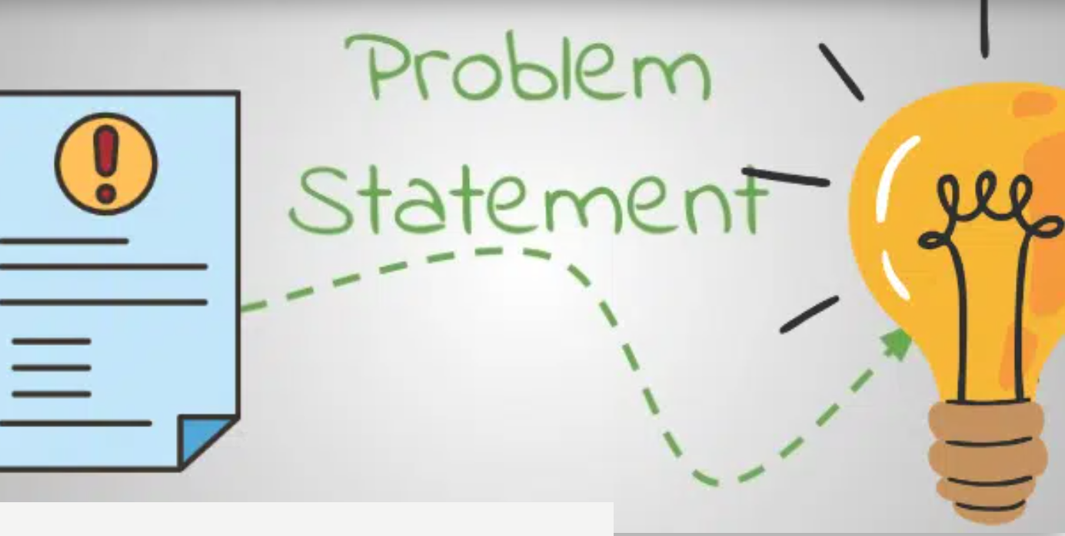
Problem Statement
Design and develop a sentiment analysis model tailored for a hospitality company to analyze customer reviews and feedback. The objective is to accurately classify each review as positive, negative, or neutral, while also identifying key topics or areas of concern mentioned by customers.

Slide 3

Objectives:
Develop a robust sentiment analysis algorithm capable of accurately classifying customer reviews into positive, negative, or neutral categories.
Implement topic modeling techniques to identify recurring themes or areas of concern within the feedback.
* Design a user-friendly interface for stakeholders to visualize sentiment trends and key topics.
Evaluate the model's performance using appropriate metrics such as accuracy, precision, recall, and F1-score.
* Iterate and refine the model based on feedback and continuous monitoring of its performance.

Slide 4

Constraints:
Data privacy and security considerations must be strictly adhered to.
The model should be scalable to handle a growing volume of feedback data.
- Limited computational resources may influence the complexity of the model architecture.

Slide 5
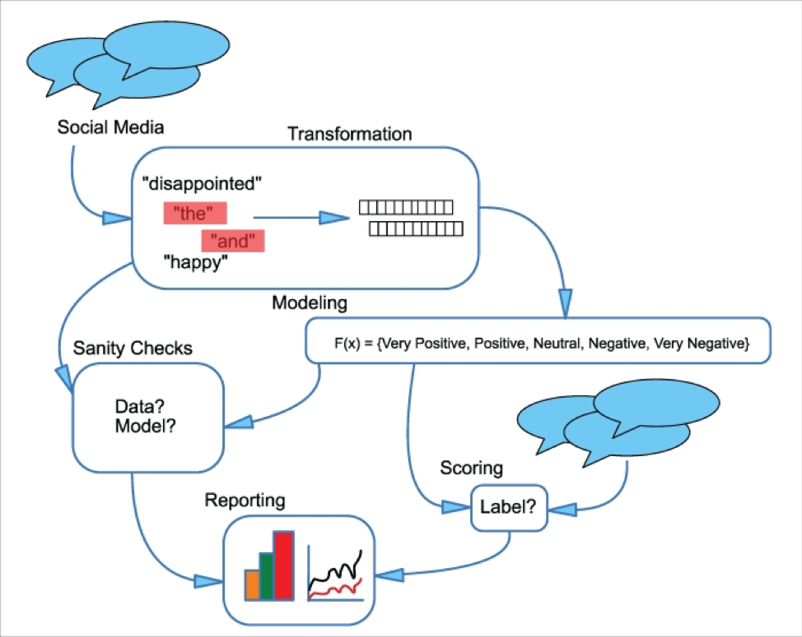
Architecture Snapshot

Slide 6



Sentiment Analysis - Hotel Review
CONTENT
SENTIMENT ANALYSIS
MACHINE LEARNING MODEL
NLTK
EXPLORATORY DATA ANALYSIS
DATASET EXPLANATION

Slide 7

Sentiment Analysis - Hotel Review
SENTIMENT ANALYSIS
What is Sentiment Analysis?
Sentiment analysis is the use of natural language processing, text analysis, computational linguistics, and biometrics to systematically identify, extract, quantify, and study affective states and subjective information, widely applied to voice of the customer materials such as reviews and survey responses typically express their opinion or sentiment.
source : https://en.wikipedia.org/wiki/Sentiment_analysis

Slide 8



Sentiment Analysis - Hotel Review
NLTK - Natural Language Toolkit
NLTK is a leading platform for building Python programs to work with human language data. It provides easy-to-use interfaces along with a suite of text processing libraries for classification,
tokenization,
stemming,
tagging,
parsing, and semantic reasoning.
Natural Language Processing with Python provides a practical introduction to programming for language processing. It guides the reader through the fundamentals of writing Python programs, working with corpora, categorizing text, analyzing linguistic
structure,
and more.
source : https://www.nltk.org/

Slide 9


Sentiment Analysis - Hotel Review
DATASET EXPLANATION
Review Column
Rating Column
Total row Null values
:
:
20491
None None
Duplicated values :

Slide 10


Sentiment Analysis - Hotel Review
EXPLORATORY DATA ANALYSIS
Exploratory Data Analysis (EDA) is an approach of analyzing data sets to summarize their main characteristics, often using statistical graphics and other data visualization methods. A statistical model can be used or not, but primarily EDA is for seeing what the data can tell us beyond the formal modeling and thereby contrasts traditional hypothesis testing.
source : https://en.wikipedia.org/wiki/Exploratory_data_analysis

Slide 11

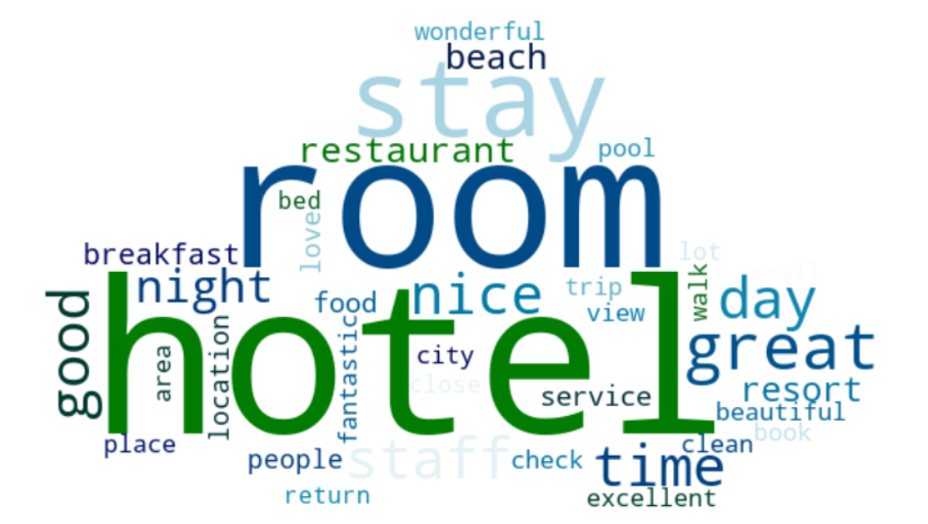
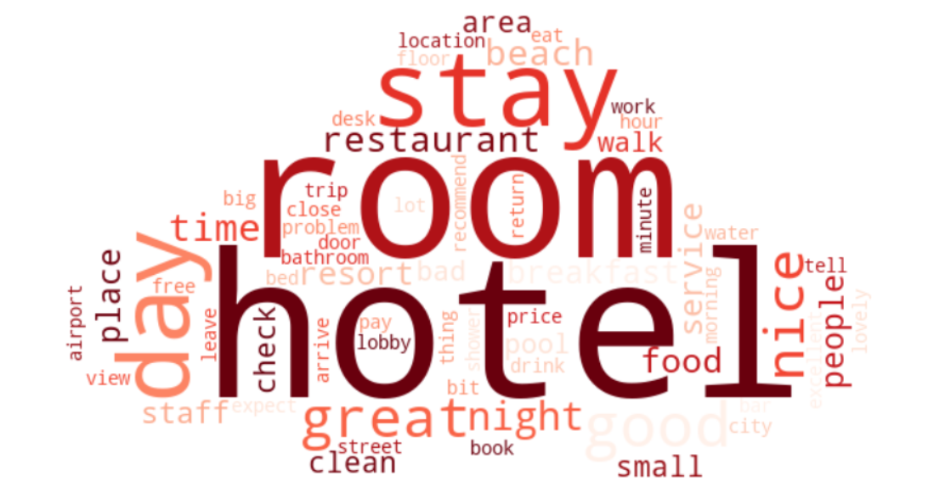
Sentiment Analysis - Hotel Review
EXPLORATORY DATA ANALYSIS
Both reviews are dominated with words like hotel, room, stay, time. But, in Positive Reviews there are much more positive and constructive words such as excellent, fantastic, beautiful, wonderful, and love. While Negative Reviews contains neutral to negative words, such as bad, problem, small, service, and leave. It means that even though both reviews mostly consist of the same words, but it has different meaning.

Slide 12

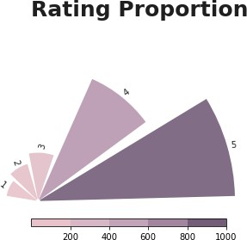
Sentiment Analysis - Hotel Review
EXPLORATORY DATA ANALYSIS
Rating proportion is dominated with 5-star review with almost surpassing 1000 reviews. 5-star review means that the hotel providing good services or products to customers. Whilst for 4-star review means customer/reviewer enjoyed the service but may point out some areas for improvement, so it is not a good thing. For 3-star to 1-star review, we can considered it as a bad review.
Based on above explanation, we can categorize it : Good Review :
Bad Review :

Slide 13

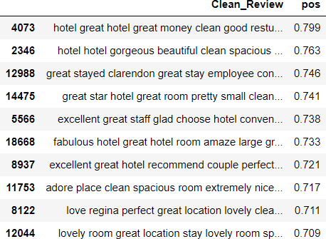
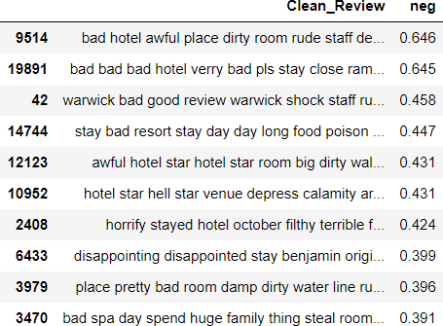
Sentiment Analysis - Hotel Review
EXPLORATORY DATA ANALYSIS
Positive Reviews, dominated with words that show high customer satisfaction, such as great, excellent, fabulous, and adore. While Negative Reviews dominated with words that show low customer satisfaction, such as bad, horrify, awful, and disappointing. It show that both describing HOTEL but with different adjective that show their satisfaction level.

Slide 14


Sentiment Analysis - Hotel Review
MACHINE LEARNING MODEL
Machine learning (ML) is a field of inquiry devoted to understanding and building methods that "learn" – that is, methods that leverage data to improve performance on some set of tasks. It is seen as a part of artificial intelligence.
Random Forest
commonly-used machine learning algorithm, which combines the output of multiple decision trees to reach a single result. Its ease of use and flexibility have fueled its adoption, as it handles both classification and regression problems.
Method to predicts a dependent data variable by analyzing the relationship between one or more existing independent variables. Here we are using logistic regression for the effective accuracy and the prediction of the data set.
Logistic Regression

Slide 15
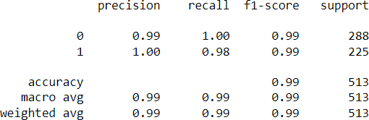
Sentiment Analysis - Hotel Review
MACHINE LEARNING
MODELING
Random Forest
Classification Decision:
This model able to achieve 97% precision for negative reviews, it means that 97% negative reviews are correctly classified as negative reviews, while 3% of negative reviews are classified incorrectly. For positive reviews, it achieved 100%, it means that all positive reviews are classified as positive reviews and none of the positive reviews are classified incorrectly.
Recall value or True Positive Rate (TPR), predicted how much a machine learning model correctly identifies all relevant cases withing the dataset. In this case, our model able to predicted that 100% from the dataset are True Positive for negative reviews, and 96% from the dataset are True Positive for positive reviews.
F1-score value measures how many times the model made a correct prediction accurately. Our logistic regression model able to predict 99% correctly for negative reviews and 98% correctly for positive reviews.

Slide 16
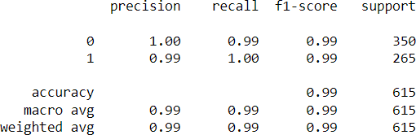
Sentiment Analysis - Hotel Review
MACHINE LEARNING
MODELING
Logistic Regression
Classification Decision:
Precision value equal to 100% for 0, means that all negative reviews are classified as negative reviews and none of the negative reviews are classified incorrectly. While precision value for positive reviews equal to 99%, it means that 99% of positive reviews are classified as positive reviews and 1% of the positive reviews are classified incorrectly.
Recall value or True Positive Rate (TPR), predicted how much a machine learning model correctly identifies all relevant cases withing the dataset. In this case, our model able to predicted that 99% from the dataset are True Positive for negative reviews, and 100% from the dataset are True Positive for positive reviews.
F1-score value measures how many times the model made a correct prediction accurately. Our logistic regression model able to predict 100% correctly for negative reviews and 99% correctly for positive reviews.

Slide 17

Success Criteria:
- Achieve an accuracy rate of at least 80% in sentiment classification.
- Identify and accurately extract key topics with a precision of 75% or higher.
- Positive feedback trends should outweigh negative ones over time.
- Stakeholders find the user interface intuitive and valuable for decision-making processes.

Slide 18

Sentiment Analysis - Hotel Review
Thank You
chushrithabandaru@gmail.com http://www.linkedin.com/in/chushrithabandaru/

